Slide 1



Innovative solutions aimed at reducing the cost of infrastructure and services while maintaining their current range in the Ore Mountains - Vejprty area
Housing in Vejprty city
Usti Region: PP5
Dalibor Spotak
Transnational Study Tour| Budapest | 20.-22.5.2014
“This project is implemented through the
CENTRAL EUROPE Programme co-financed
by the ERDF.”

Slide 2

CZECH REPUBLIC
HOUSING
Construction of the housing stock is decreasing
Usti Region
2007: 1 913 new flats
2008: 1 829 new flats
2009: 1 631 new flats
2010: 1 220 new flats
2011: 1 197 new flats
2012: 1 141 new flats
Source: Dlouhodobý vývoj bytové výstavby v ČR, 2013
(Long-term development of housing construction in the Czech Republic, 2013)

Slide 3
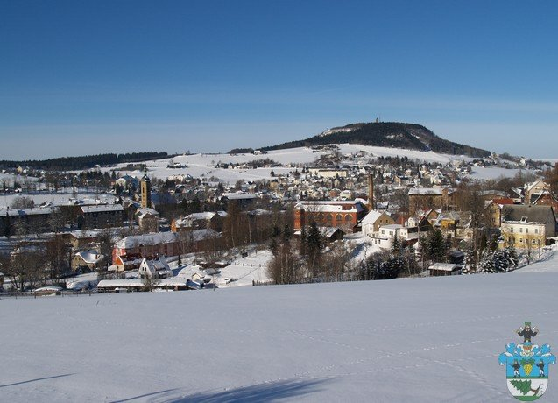
CITY OF VEJPRTY
The border area around the Ore Mountains called Vejprty is a rural area.
The city of Vejprty where
there was a significant drop
in the population, especially
after the Second World War.
This decrease was caused
by the displacement
of the German population after the second World War.
Notes:
Podlouhlý obrázek graf roční spotřeby energie na vytápění. Objekt je v centru města, částečně využívaný

Slide 4
CITY OF VEJPRTY
Since 2001 the population has stabilized but the second factor has begun to grow in importance - the aging population
The area has about 3000 inhabitants.
Geographical area is 977 ha.
Year | 2001 | 2002 | 2003 | 2004 | 2005 | 2006 | 2007 | 2008 | 2009 | 2010 | 2011
Vejprty | 3 334 | 3 309 | 3 322 | 3 273 | 3 238 | 3 261 | 3 237 | 3 280 | 3 314 | 3 299 | 3 134
Notes:
Podlouhlý obrázek graf roční spotřeby energie na vytápění. Objekt je v centru města, částečně využívaný

Slide 5
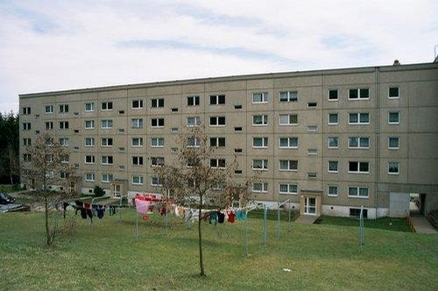
CITY OF VEJPRTY
No. occupied houses: 476
No. occupied flats: 1070
Currently, the city manages
63 apartment buildings,
which is about 600 flats.
This number would like
to establish some thirty
to forty caretakers.
Notes:
Dle doporučení pro nové využití by měl objekt sloužit jako administrativní budova. Objekt není využíván a byl postaven kolem roku 1924.

Slide 6
CITY OF VEJPRTY
The increasing number of abandoned/empty public and private buildings in the municipalities of the Vejprty area most severely hit by shrinking processes.
There are many former hospitals, nursery schools, shopping centres, factories that were abandoned or are currently partly used and decayed due to the loss of clients.
Notes:
Budova plně slouží jako Domov pro osoby se zdravotním postižením. Postaven okolo 1930

Slide 7
CITY OF VEJPRTY
Maintenance costs
High maintance costs – importance of cost savings – especially in insulation of buildings
Replacement of windows etc. which save up to 25% energy costs belongs to the most efficient measures....
Experience of city of Vejprty: DONE
NO. Of insulationf of block of flats: 9
Saving: 48 – 52% energy costs
Local budget savings: 3,5 mil. CZK (approx. 0,129 mil. EUR)
Notes:
Budova plně slouží jako Domov pro osoby se zdravotním postižením. Postaven okolo 1930

Slide 8
CITY OF VEJPRTY
Experience of city of Vejprty: 2014
NO. Of insulationf of block of flats: 12
Saving: 48 – 52% energy costs
Local budget savings: 6 mil. CZK (approx. 0,222 mil. EUR)

Slide 9
CITY OF VEJPRTY
Process:
select building (maitanance costs, no. Population etc.)
voting by City Counsil
Preparing supported materials: Energy audit, Energy certificate, Project documentation, Building permit
Possibility of obtaining grants – preparing AF + supported materials
Tender for a contractor
Reconstruction building
RESULT: Thermal insulation of buildings, improve the quality of housing and cost savings (local budget)

Slide 10
CITY OF VEJPRTY
Strengths and weaknesses:
Strengths:
Cooperation with public administration and other entities in the region has strengthened
Weaknesses:
Principal decision making is only in the hands of politicians
High financial demands of the follow-up investments
Long processes

Slide 11

The work team
Usti Region project partner
Thank you for your attention
Dalibor Spotak

