Slide 1

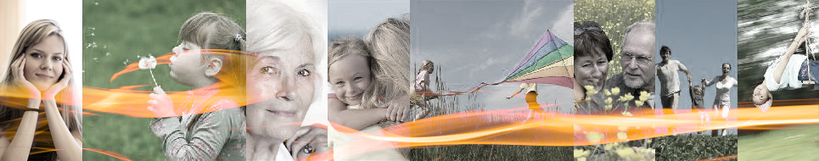
Innovative solutions aimed at reducing the cost of infrastructure and services while maintaining their current range in the Krusne hory - Vejprty area
Housing and energy savings
Update on pilot action implementation
Usti Region; PP5
Michaela Rehakova
5th Partner Meeting | Budapest | 26-28.11.2013
“This project is implemented through the
CENTRAL EUROPE Programme co-financed
by the ERDF.”

Slide 2


ACHIEVED RESULTS
July 2012 contract with service provider
November 2012 Analysis of strategic documents – Vejprty area
4th October 2012 Workshop Pilot action development 4.2.3
August 2013 Contribution to 4.2.8 Transnational Guidebook for Pilot Action Implementation
November 2013 our Pilot Action is completed we can evalaute now…

Slide 3
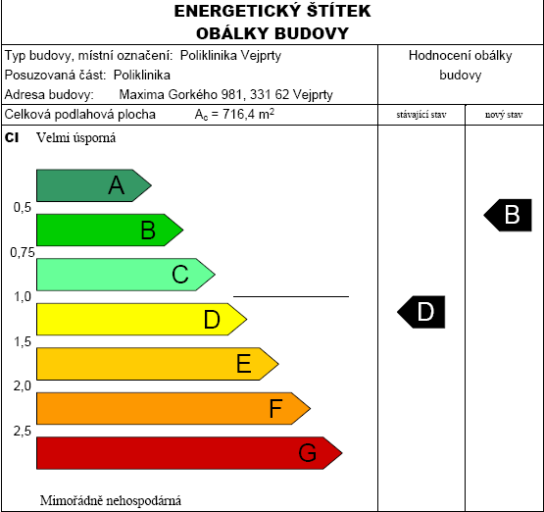
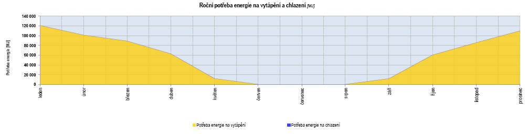
Pilot Action by teps
March 2013
Nr.1 House of Policlinic in Vejprty
Energetic audit
Certificate of performance characteristic
Disposal solutions study
Notes:
Podlouhlý obrázek graf roční spotřeby energie na vytápění. Objekt je v centru města, částečně využívaný

Slide 4
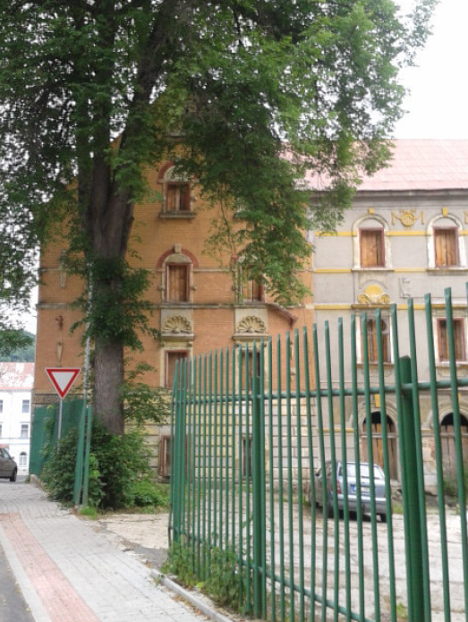
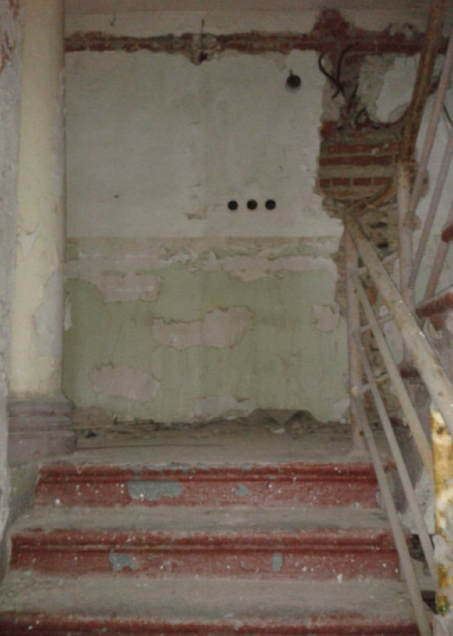
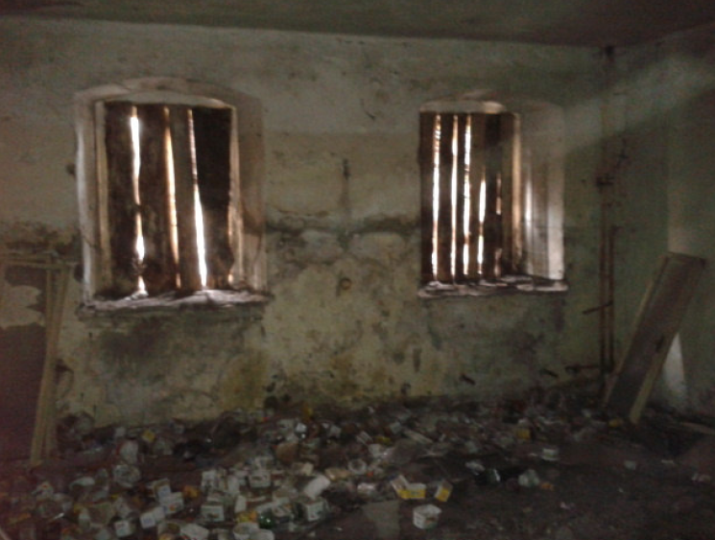
Pilot Action by teps
July 2013
Nr.2 House of former recreation center Residential building company
Energetic audit
Certificate of performance characteristic
Disposal solutions study
Notes:
Dle doporučení pro nové využití by měl objekt sloužit jako administrativní budova. Objekt není využíván a byl postaven kolem roku 1924.

Slide 5
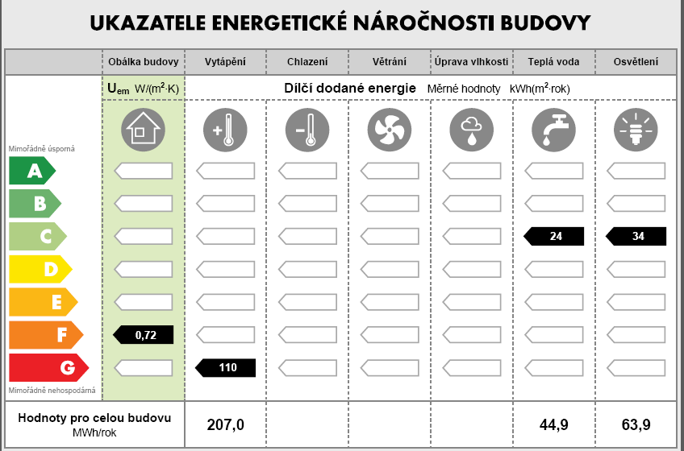
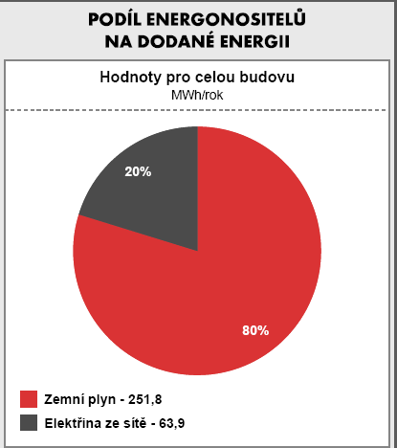
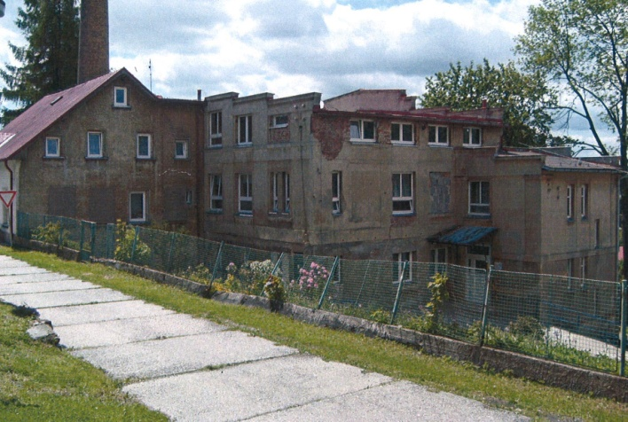
Pilot Action by teps
October 2013
Nr.3 Building: Home for disabled persons in Vejprty
Energetic audit
Certificate of performance characteristic
Disposal solutions study
Notes:
Budova plně slouží jako Domov pro osoby se zdravotním postižením. Postaven okolo 1930

Slide 6
TIME SCHEDULE
DEADLINE | ACTIVITY / MILESTONE
July 2012 | contract with service provider
November 2012 | Analysis of strategic documents – Vejprty area
October 2012 | Workshop Pilot action development 4.2.3
August 2013 | Contribution to 4.2.8 Transnational Guidebook for Pilot Action Implementation
November 2013 | All three sub-parts of Pilot Actions are completed
To end of 2013 | Pilot Action evaluation

Slide 7

The work team Usti Region project partner
Michaela Rehakova, Dalibor Spotak, Martina Kucerova

