Slide 1
Transnational baseline and monitoring with stakeholder involvement (WP3)
Anna Páldy, Tamás Pándics, János Bobvos, Márta Szalkai, Balázs Fazekas, Péter Rudnai
National Institute of Environmental Health, Budapest
17-18 September 2012
Sosnowiec, Poland

Slide 2
Introduction
Building a transnational data base through
  vulnerability assessment and SWOT analysis
  continuous measurement and monitoring
to assess the nature and extent of air pollution and its links to health with strong stakeholder involvement

Slide 3
Introduction
Based on air pollution and health data a virtual observatory will be established to
  store and assess data on air pollution
  create a basis for preparation and implementation of the planned tools/actions
The process is supported by consultations with the Healthy Environment Platforms (HEP) established by PP regions to set up the core output under WP4

Slide 4
Actions
3.1 Baseline analysis
3.2 Virtual observatory
3.3 Health Environment Platform

Slide 5
Action 1: Transnational baseline
Vulnerability assessment (VA)
The comparative VA will define common problems and challenges
SWOT by PPs will define actions needed to face these challenges
VAs and SWOTs will serve as baselines for the Adaptation Action Plans (WP4)

Slide 6
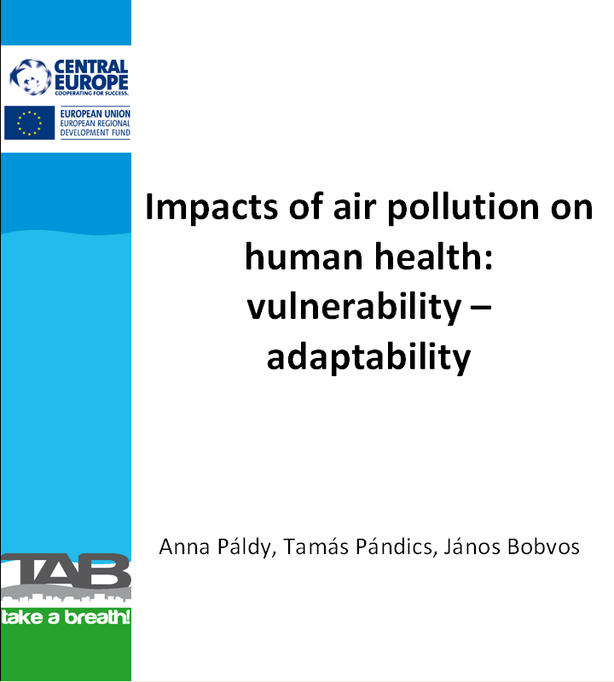
Action 1: Transnational baseline
Vulnerability assessment (VA)
What has already been done:
Methodology for VA has been completed after a consultation with PP6, and has been sent to all PPs

Slide 7
Action 1: Transnational baseline
Vulnerability assessment (VA)
What has already been done:
Data availability questionnaire has been prepared and sent to all PPs
After assessment of data availability questionnaire a data request form has been sent to all PPs

Slide 8
Action 1: Transnational baseline
Vulnerability assessment (VA)
What has already been done:
Data availability questionnaire has been prepared and sent to all PPs
After assessment of data availability questionnaire a data request form has been sent to all PPs

Slide 9
Data needs and actions

Slide 10
Vulnerability assessment
Vulnerability:
yearly excess mortality due to AP
Actions:
alert
legislation
health care
public information
Adaptation-adaptation capacity:
socioeconomic status,
qualification
willingness
Exposure:
Air pollution
Vulnerability : age,
Baseline mortality, diseases etc
Data source:
Local AQ monitoring station
Data source:
National statistics,
local statistics
Environmental impact
Population
Páldy&Bobvos. In: SEBEZHETŐSÉG ÉS ADAPTÁCIÓ szerk. Bulla M. és Tamás P., 2011,

Slide 11
Vulnerability
Mortality data of the examined city:
Data source: optimal minimal
    nat. stat. office or local stat. office
    Local municipality
    Civil registry

Slide 12
Data from the National Statistical Office
International Statistical Classification of Diseases and Related Health Problems (ICD-10) is used to assess environmental health conditions. Needs standardization:
  Total mortality data of the town and at national level for the last 5 years (2006-2010) or for the last available year by age groups and by sex:
  optimal: 0-4, 5-9, 10-14,…….85-x
  Minimal: 0-14, 15-64, 65-x

Slide 13
Data from the national statistical office
Mortality by causes:
Lung cancer: ICD-10: C33-C34
Cardiovascular diseases ICD-10: I00-I99
Respiratory diseases ICD-10: J00-J99
Optimal: by age groups and by sex (see prev. slide)
Medium: in age groups 0-65 and 65-x
Minimal: for the total population

Slide 14
Action 1: Transnational baseline
Vulnerability assessment (VA)
What should we do:
Vulnerability assessment (VA) will be prepared by PPs

Slide 15
Action 2: Virtual observatory
To set up the virtual observatory PPs will collect or measure air pollution (PM, NOx, SO2, O3)
  on-line monitoring (location with heavy traffic and „background station” if there is such a station)
  Occasional sampling in every season 2 weeks (background exposure)

Slide 16
AQ monitoring data
From the local monitoring network
Data from „background station(s)” for at least 1 year, data for every day
PM10 – 24 hour mean
NO2- 24 hour mean
O3 max of 8-hour moving average
SO2 - 24 hour mean

Slide 17
Action
PPs:
  Mortality data collection
  AQ data collection
  4 PPs have sent back our data request form
NIEH
  Standardisation of mortality data, assessment of baseline health state of the participating cities
  EHIA of AQ (yearly excess deaths due to AP of the towns)

Slide 18
Results
EHIA of AQ: short term impact of PM10 in Upper Silesian Region, Usti, Velenje, Várpalota
Short term impact of O3 pollution in Várpalota
Long term impact of PM2.5 in Várpalota

Slide 19
Results
Methodology: AirQ2.2 software
Computation of
the short-term impact of PM10 on total non-external, cardiovascular and respiratory mortality
the short-term impact of ozone on total non-external and cardiovascular mortality

Slide 20
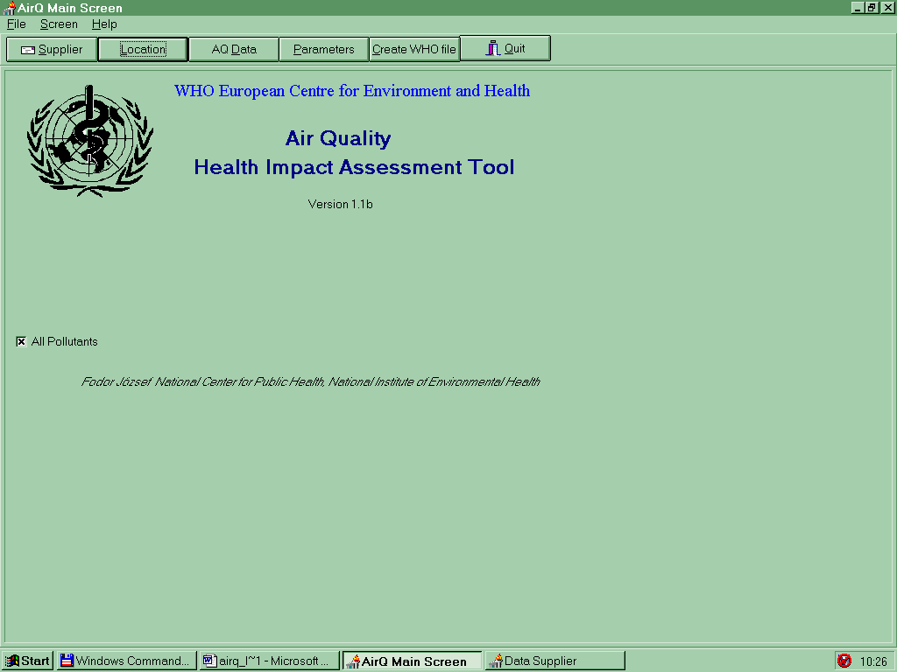
AirQ2.2. software
The Air Quality Health Impact Assessment Tool (AirQ) is a
specialized software
that enables the user
to assess the potential impact on human health of
exposure to a given air pollutant
in a defined urban area
during a certain time period.

Slide 21
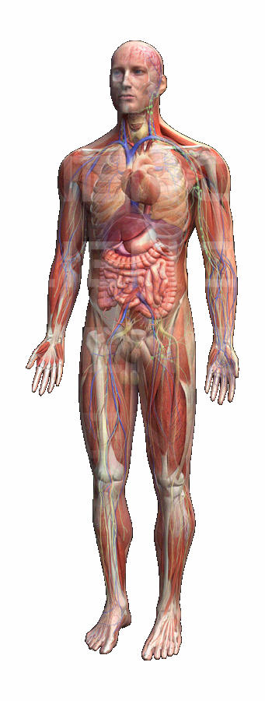
How inhalation of particualte matter may affect human health
Pope és Dockery (2006)
Increased cerebrovascular and myocardial ischaemia, altered cardiac repolarization,.
Lungs: inflammation, oxydative stress, accelerated progression and exacerbation of COPD, increased respiratory symmptoms, effeectsd pulmonary reflexes, reduced lung function.
Blood: increased coagulopathy, translocated particles, peripheral thrombosis, reduced oxygen saturation
Systemic inflammation, oxydative stress: increased CRP, proinflammatory mediators, leukocyte&platelet activation.

Slide 22
Relative risks values of some air pollutants
Health outcome | Age group | RELATiVE RISK
 |  | PM10-short term | PM2.5 – long term | Ozone-short term
MORTALITY
All non-external cause | 0-X | 1,0074 (1,0062-1,0086) | 1,06 (1,02-1,1) | 1,0031 (1,0017-1,0052)
Cardiovascular diseases | 0-X | 1,008 (1,005-1,018) | -
Respiratory diseases | 0-X | 1,012 (1,0048-1,037) | -

Slide 23
Calculation of excess number of deaths due to air pollution
Distribution of concentration categories of air pollutants
Relative risk values
Attributable risk (AR)
Incidence (I)
Number of population (N)
N _{excess deaths}= I × AR × N
Number of excess death cases

Slide 24
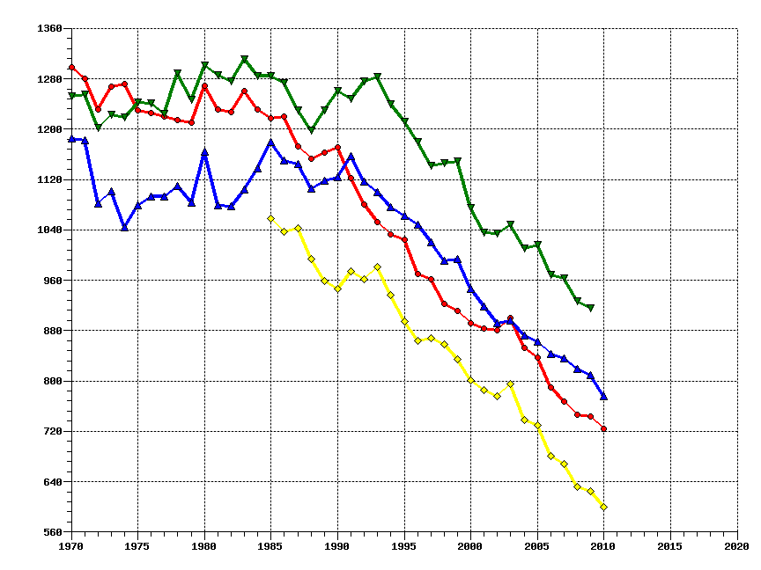
Standardized death rate all causes, all ages, per 100000
Countries
Czech Rep
Hungary
Poland
Slovenia
Source: WHO/HFA database, 2012.

Slide 25
Descriptive results: Yearly baseline total, cardiovascular and respiratory mortality /100 000 in the PP regions and towns, 2006-2010

Slide 26
Descriptive results: Yearly mean PM10 concentration (ug/m3) in the PP regions and towns, 2006-2010
Yearly limit value

Slide 27
Distribution of daily PM10 concentration categories (ug/m3) in Upper Silesian Region 2006-2007
Daily limit value
EU legislation: 35 days with daily conc>50 ug/m3 are allowed in a year!
152
96

Slide 28
Smog episodes in USR 2006-2010
date | daily PM10 |  | date | daily PM10 |  | date | daily PM10 |  | date | daily PM10
2006-01-08 | 117,9 |  | 2007-11-20 | 133,5 |  | 2009-01-10 | 129,29 |  | 2010-02-15 | 148,07
2006-01-09 | 176,0 |  | 2007-11-21 | 252,3 |  | 2009-01-11 | 118,99 |  | 2010-02-16 | 169,10
2006-01-10 | 305,6 |  | 2007-11-22 | 194,0 |  | 2009-01-12 | 191,68 |  | 2010-02-17 | 140,06
2006-01-11 | 404,3 |  | 2007-11-23 | 237,3 |  | 2009-01-13 | 186,89 |  | 2010-02-18 | 146,57
2006-01-12 | 367,7 |  | 2007-11-24 | 100,6 |  | 2009-01-14 | 194,93 |  | 2010-02-19 | 93,42
2006-01-13 | 40,9 |  |  |  |  | 2009-01-15 | 134,25
2006-01-14 | 47,5 |  |  |  |  | 2009-01-16 | 53,50 |  | 2010-12-03 | 107,3
2006-01-15 | 134,4 |  | 2008-12-29 | 75,92 |  | 2009-01-17 | 108,25 |  | 2010-12-04 | 215,7
2006-01-16 | 242,7 |  | 2008-12-30 | 222,57 |  | 2009-01-18 | 108,07 |  | 2010-12-05 | 226,2
2006-01-17 | 212,2 |  | 2008-12-31 | 309,29 |  | 2009-01-19 | 57,26 |  | 2010-12-06 | 79,8
 |  |  |  |  |  | 2009-01-20 | 164,13 |  | 2010-12-07 | 129,9
2006-01-26 | 368,8 |  |  |  |  | 2009-01-21 | 174,88 |  | 2010-12-08 | 170,0
2006-01-27 | 441,8 |  |  |  |  | 2009-01-22 | 85,01
2006-01-28 | 382,7 |  |  |  |  | 2009-01-23 | 75,41 |  | 2010-12-16 | 173,5
2006-01-29 | 425,5 |  |  |  |  | 2009-01-24 | 117,06 |  | 2010-12-17 | 178,3
2006-01-30 | 226,6 |  |  |  |  | 2009-01-25 | 143,96 |  | 2010-12-18 | 245,7
 |  |  |  |  |  |  |  |  | 2010-12-19 | 87,4
2006-02-05 | 164,9 |  |  |  |  |  |  |  | 2010-12-20 | 46,2
2006-02-06 | 254,5 |  |  |  |  |  |  |  | 2010-12-21 | 115,3
 |  |  |  |  |  |  |  |  | 2010-12-22 | 146,1
2006-11-16 | 156,6 |  |  |  |  |  |  |  | 2010-12-23 | 104,0
2006-11-17 | 175,5
2006-11-18 | 122,7 |  |  |  |  |  |  |  | 2010-12-27 | 193,8
2006-11-19 | 121,9 |  |  |  |  |  |  |  | 2010-12-28 | 124,0
2006-11-20 | 75,4 |  |  |  |  |  |  |  | 2010-12-29 | 131,8
2006-11-21 | 68,1 |  |  |  |  |  |  |  | 2010-12-30 | 99,5
2006-11-22 | 102,7
2006-11-23 | 65,5
2006-11-24 | 165,8
2006-11-25 | 96,3
2006-11-26 | 166,8
2006-11-27 | 147,8
2006-11-28 | 124,2
2006-11-29 | 106,4

Slide 29
Smog episodes in Usti 2006-2010
date | daily PM10 |  | date | daily PM10
2006-01-09 | 128,6 |  | 2008-02-11 | 132,9
2006-01-10 | 188 |  | 2008-02-12 | 143
2006-01-11 | 212,8 |  | 2008-02-13 | 131,3
2006-01-12 | 259
2006-01-13 | 96,2 |  | 2009-01-10 | 112,5
 |  |  | 2009-01-11 | 70
2006-01-23 | 100,5 |  | 2009-01-12 | 109,8
2006-01-24 | 159,5 |  | 2009-01-13 | 90,9
2006-01-25 | 77,6 |  | 2009-01-14 | 133
2006-01-26 | 67,3 |  | 2009-01-15 | 215,2
2006-01-27 | 119,3 |  | 2009-01-16 | 99,6
2006-01-28 | 174,8
2006-01-29 | 240,9 |  | 2010-12-03 | 197,9
2006-01-30 | 325,3 |  | 2010-12-04 | 146
2006-01-31 | 207,5 |  | 2010-12-05 | 75,5
2006-02-01 | 126,5 |  | 2010-12-06 | 111,2
2006-02-02 | 182,4
2006-02-03 | 159,1

Slide 30
Smog episodes in Várpalota 2006-2010
date | pm10 |  | date | pm10
09.01.06 | 77 |  | 18.12.10 | 82
10.01.06 | 113 |  | 19.12.10 | 156
11.01.06 | 133 |  | 20.12.10 | 165
12.01.06 | 117 |  | 21.12.10 | 120
13.01.06 | 117 |  | 22.12.10 | 149
14.01.06 | 85 |  | 23.12.10 | 106
15.01.06 | 69
16.01.06 | 76 |  | 25.01.10 | 96
17.01.06 | 90 |  | 26.01.10 | 81
18.01.06 | 76 |  | 27.01.10 | 149
19.01.06 | 47 |  | 28.01.10 | 82
20.01.06 | 85 |  | 29.01.10 | 129
21.01.06 | 80
22.01.06 | 44 |  | 18.12.10 | 82
23.01.06 | 78 |  | 19.12.10 | 156
24.01.06 | 120 |  | 20.12.10 | 165
25.01.06 | 110 |  | 21.12.10 | 120
26.01.06 | 108 |  | 22.12.10 | 149
27.01.06 | 138 |  | 23.12.10 | 106
28.01.06 | 169
29.01.06 | 177
30.01.06 | 179
31.01.06 | 120
01.02.06 | 115
02.02.06 | 124
03.02.06 | 128
04.02.06 | 93

Slide 31
Smog episodes in Velenje 2006-2010
date | daily PM10 |  |  | date | daily PM10
2006-01-26 | 88 |  |  | 2009-01-06 | 72
2006-01-27 | 116 |  |  | 2009-01-07 | 68
2006-01-28 | 90 |  |  | 2009-01-08 | 70
2006-01-29 | 139 |  |  | 2009-01-09 | 36
2006-01-30 | 163 |  |  | 2009-01-10 | 58
 |  |  |  | 2009-01-11 | 117
 |  |  |  | 2009-01-12 | 109
2007-12-21 | 77 |  |  | 2009-01-13 | 128
2007-12-22 | 93 |  |  | 2009-01-14 | 123
2007-12-23 | 96 |  |  | 2009-01-15 | 104
2007-12-24 | 76
2007-12-25 | 65
2007-12-26 |  |  |  | 2010-01-23 | 73
2007-12-27 |  |  |  | 2010-01-24
2007-12-28 | 56 |  |  | 2010-01-25
2007-12-29 | 60 |  |  | 2010-01-26 | 74
2007-12-30
2007-12-31 |  |  |  | 2010-12-30 | 72
2008-01-01 | 60 |  |  | 2010-12-31 | 94
2008-01-04 | 60
2008-01-05 | 102
2008-01-06 | 62

Slide 32
Excess mortality (per 100 000) due to short term effect of PM10 pollution >50 ug/m3 in the PP towns, 2006-2010

Slide 33
Excess mortality due to short term effect of PM10 pollution>40 ug/m3 in the PP towns, 2006-2010

Slide 34
EHIA: health gain by reducing short term PM10 pollution by 2 scenarios
Scenario 1: the PM10 yearly mean is decreased by 5 μg/m3
Scenario 2: the PM10 yearly mean is decreased to 20 μg/m3

Slide 35
EHIA of AQ: short term gain (life/100 000) of the reduction of PM10 concentration (ug/3) by different scenarios in USR, Usti, Velenje, Várpalota

Slide 36
EHIA: health gain by reducing short term O3 pollution by 2 scenarios
Excess mortality on days with O3 conc>100 ug/m3 is shown
Two scenarios are considered
where all the maximum 8-hours concentrations >100 are decreased to 100 μg/m3
where the ozone yearly mean is decreased by 5 μg/m3

Slide 37
Short term impact of O3 pollution in Várpalota

Slide 38
EHIA: health gain by reducing long term PM2.5 pollution by 2 scenarios
Methods
PM2.5 is computed from PM10 multiplied by 0.58
computation of the loss in life expectancy
the period life expectancy at age 30 is calculated
results are expressed as reduction in the annual number of deaths per 100 000
Scenario 1, where the PM2.5 yearly mean is decrease to 5 μg/m3
Scenario 2: the PM2.5 yearly mean is decreased to 10 μg/m3

Slide 39
Long term health gains of reducing PM2.5 concentration (ug/m3) in Várpalota annual number of deaths avoided

Slide 40
Further calculations
Standardized all cause, CV respiratory, lung cancer mortality for each PP region and town
Short term effects of NO2, SO2, O3 for each PP region and town
Long term effect of PM10 for each region and PP town
Long term effect of O3 for each PP region and town

Slide 41
Action 3: Healthy Environment Platforms
HEP will be set up at each location
    the joint baseline methodologies, their findings together with the quality & relevance of the VO data will be consulted in workshops attended by PPs/stakeholders
    the platform will be adapted to existing decision mechanisms within the local areas

Slide 42
Action 3: Healthy Environment Platforms
HEPs will meet regularly, 5 times during the project lifetime at the 5 PP cities with the aim to
    maximise the impact of transnational exchange by promoting communication between all stakeholders
    mobilize and engage stakeholders
    ensure quality check of local project outputs
    disseminate project results

Slide 43
Action 3: Healthy Environment Platforms
  Main elements of HEP:
    Outdoor air quality
    Health status of population
    Actions to reduce local exposure
    Optional:
      Epidemiological assessment of the data
      Risk assessment >> air quality index
      Yearly excess morbidity of children due to air pollution

Slide 44
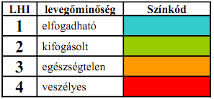
Air quality health index
Based on air pollution (PM, NOx, CO, SO₂, O₃) in the last 24 h
Semiquantitative risk assessment
4 color-coded categories:
    1 low
    2 moderate
    3 high
    4 very high
    health risk
Easier to understand for non-professionals
Daily health tips for risk groups depending on air quality

Slide 45
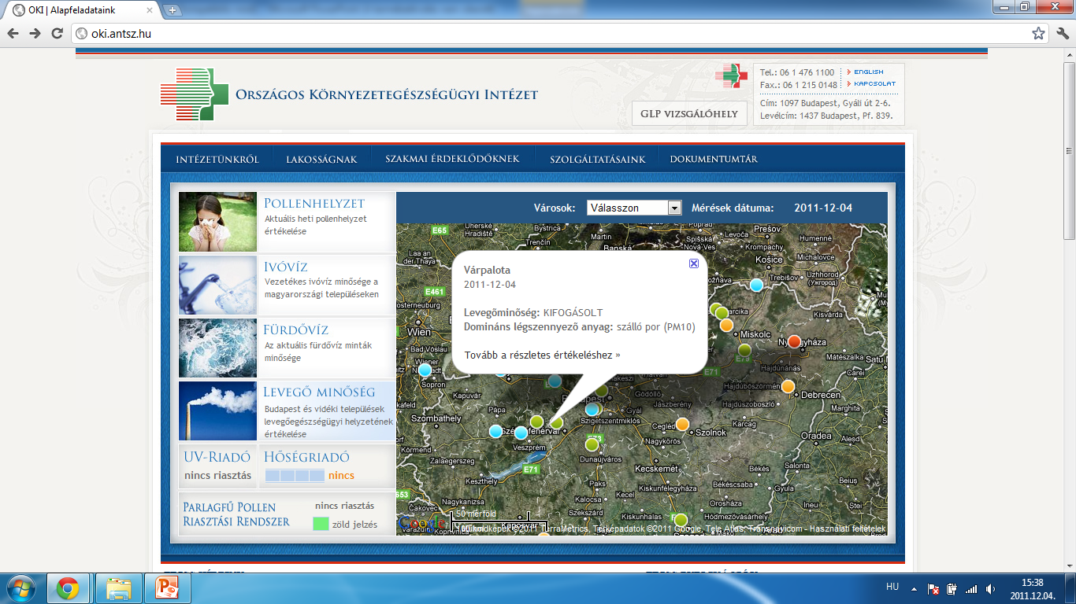
Air quality health index

Slide 46
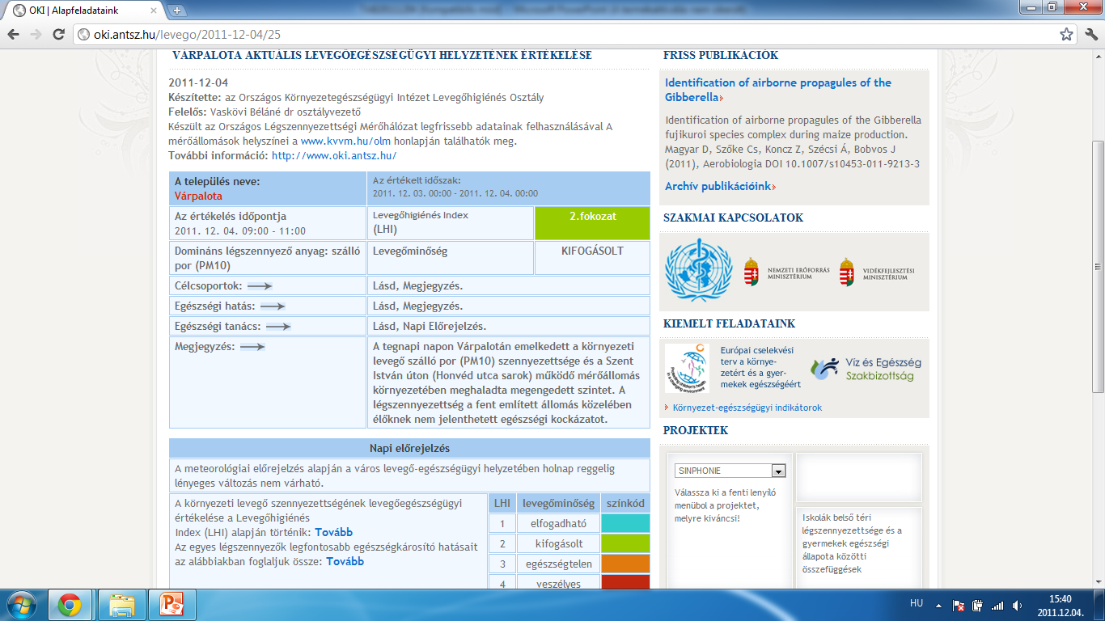
Air quality health index

Slide 47
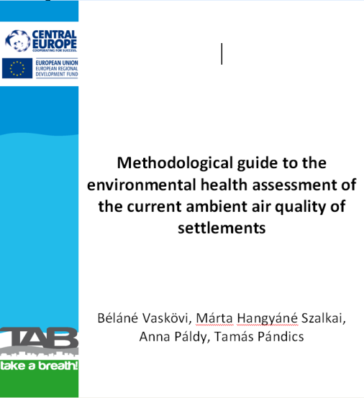
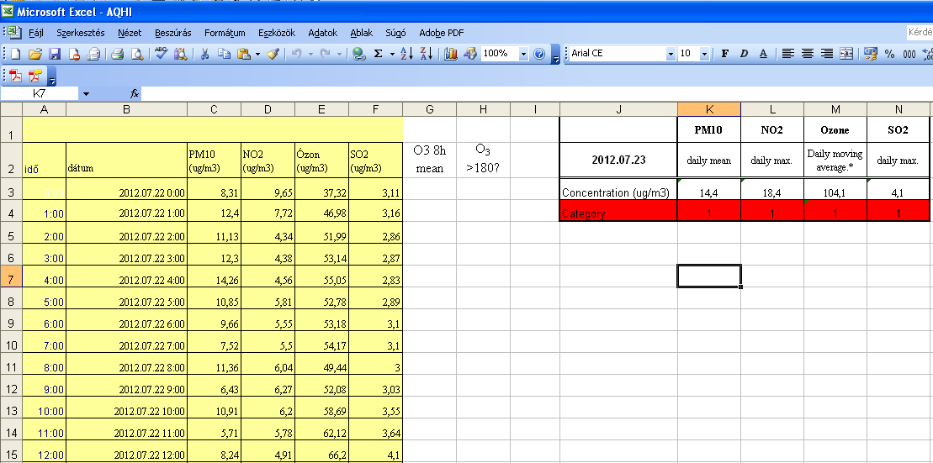
Air quality health index
A background paper has been
prepared for the PPs (you will receive it
after the meeting)
An excel sheet has been
prepared
for easy calculation of AQHI

Slide 48
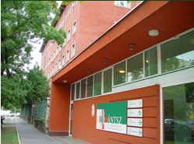
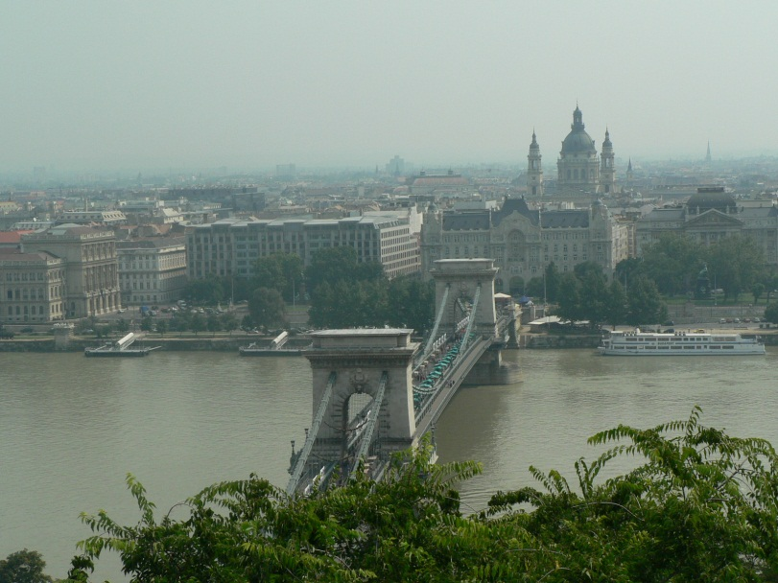
Thank You for Your attention

