Slide 1


Current Status of Work
Dalibor Spotak
Regional Authority of Usti Region
2nd Consortium Meeting | Ostana/Piedmont |20th June 2012

Slide 2

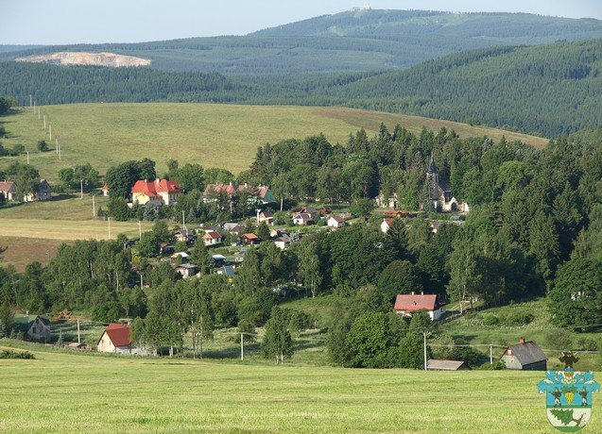
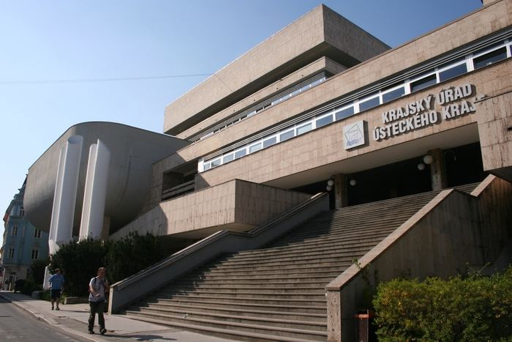
Aims of project partner Usti Region
Brief description of the objectives of the project partner
Usti Region will implement the project on the affected area- Vejprty city and its surroundings. This area is located in the borderarea. Border with Saxony. Focusing on infrastructure saving solutions, energy savings in street lighting, the utilization of public buildings. Also will be solute cooperation of the neighboring villages with Vejprty city for snow removal and road maintenance.

Slide 3
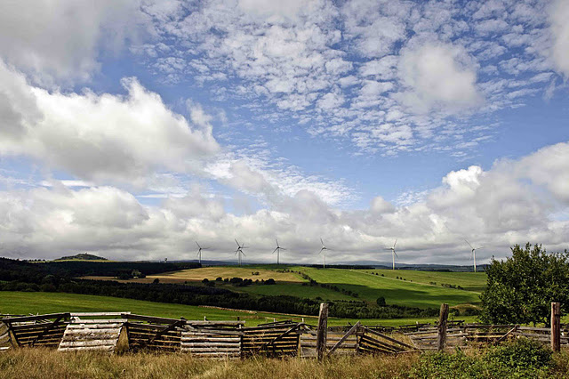
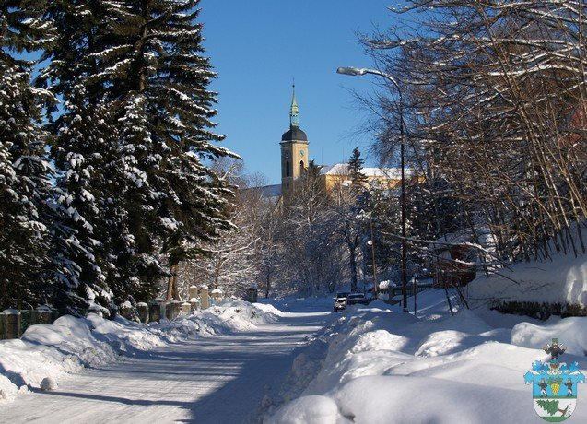
Expected project outcomes
elaboration strategies and measures for the restructuring of infrastructure and services.
developement of regional statistics, the cost of services and infrastructure
definate needs of Usti Region and to propose of cost saving policy
Investment opportunity for the pilot action
trainings (schoolings), information material for the developement of skills and knowledge services namely for regional and local government

Slide 4
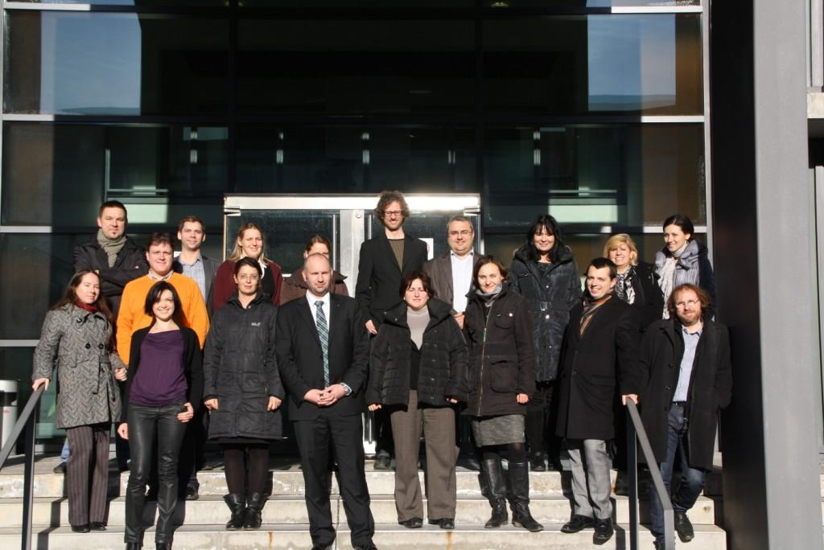
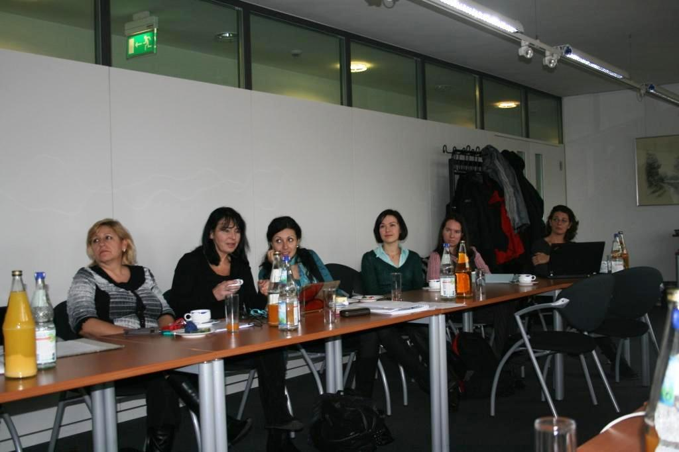
Erfurt and follow up activities
Preparation activities under the schedule defined in the application form and detailed in Erfurt.
on the main official web site of Usti Region has been published material from kick off meeting including photos and minutes.
It has been created e structured project web space, that is consantly updated
Notes:
Interní schůzka – projednání způsobu vkládání nových informací a jejich třídění. Rozdělení kompetencí na jednotlivé projekty. Založení sekcí, které budou obsahovat jak tabulku připravovaných a uskutečněných akcí, tak dílčích dokumentů i fotografií. Následné faktické doplnění o již nastřádané dokumenty a přehled aktivit

Slide 5
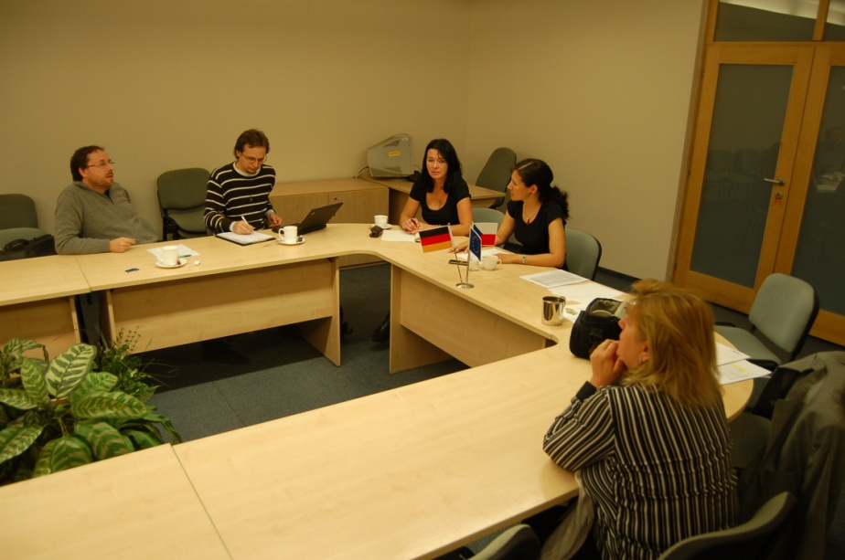
Analysis of declining urban regions of Central Europe
The main activity during the first period of the project, preparing for the pilot action
language translation of materials for the cooperation in frame of project and for accurate searching required data
completion of questionnaire to find statistical data, comparison of values of demographic and economic indicators
was initiated a public tender for service
provider to data collection and analysis
(after checking the first level control
will be signed a contract for work)
Notes:
Spolupráce s kolegy s Soc. ústavu AV ČR sešli jsme se na schůzce, porovnávali a hledali zdroje dat.

Slide 6
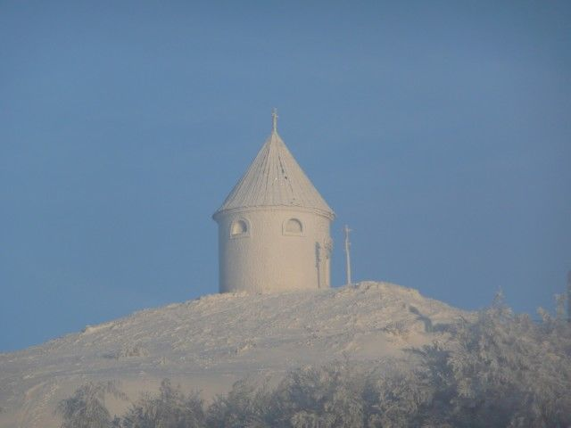
What is currently proceeds and will soon
the following actions
at first to sign contract for work with a selected provider
to complete a Progress and Activity report for the first period
closer cooperation with people from affected regions
publications according to the program Central Europe manual

Slide 7

For the team ADAPT2DC by the Authority of Usti Region thank you for your attention.
Let our work is beneficial!
Dalibor Spotak
project manager
Regional Authority of UstI Region
Department of Strategy Preparation and Project Launch
Velka Hradebni 3118/48
UstI nad Labem
400 01
Czech Republic
Tel: +420 475 657 938

